Slide 1
Azure Overview
Kris Swanson
Microsoft Partner Technology Strategist

Slide 2

Cloud
Microsoft Cloud
Global Trusted Hybrid
Notes:
Microsoft Cloud (inclusive of Azure and Office 365) is about 3 things: Global scale, Trusted (by enterprises and partners alike), and Hybrid

Slide 3
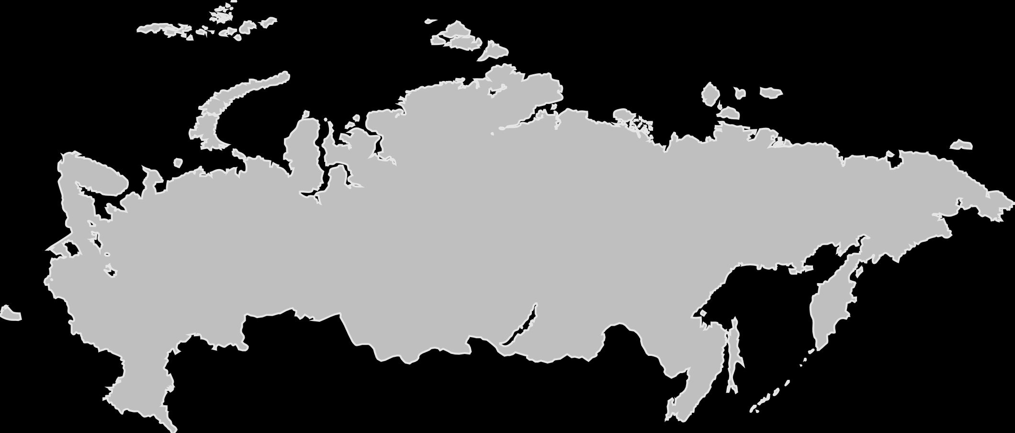
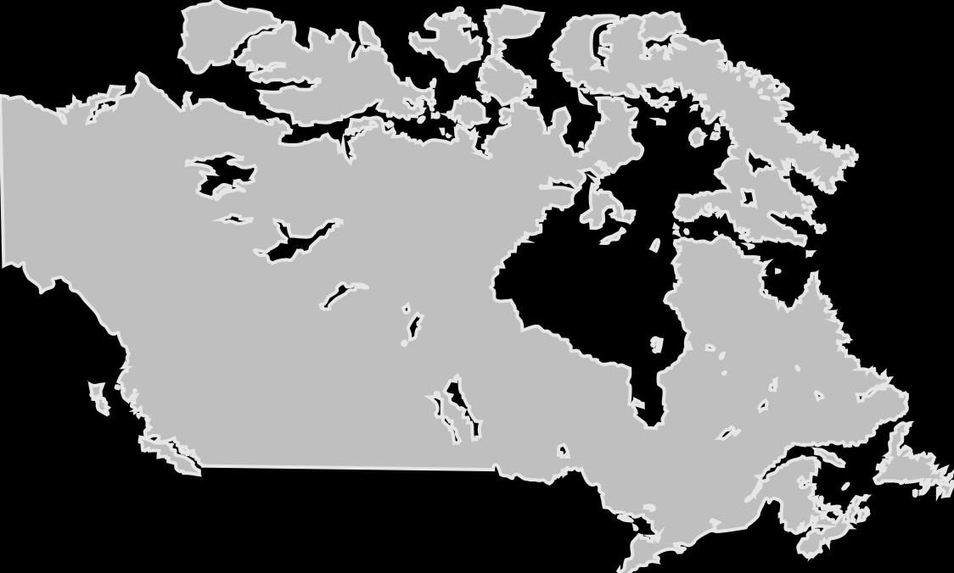
Global scale
54
Azure regions
More than AWS & Google combined
Notes:
In order to help organizations meet data residency, sovereignty and compliance requirements, Microsoft has a worldwide network of 32 Microsoft-managed Azure regions operations and plans for 6 additional regions and continues to make significant investments in geo-expansion through our local and sovereign offerings in more than 10 unique geographic regions worldwide.

Slide 4
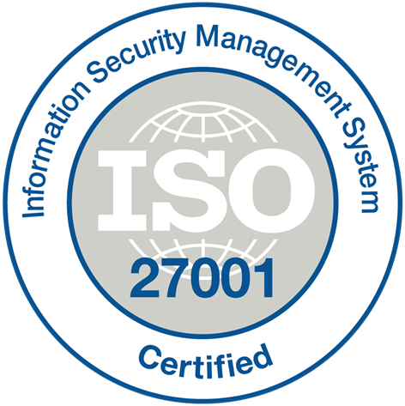
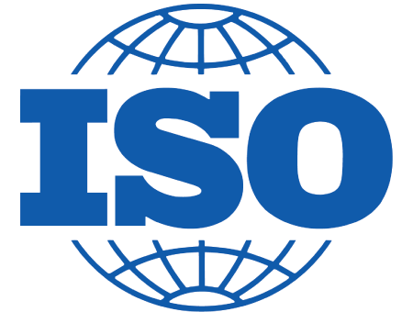
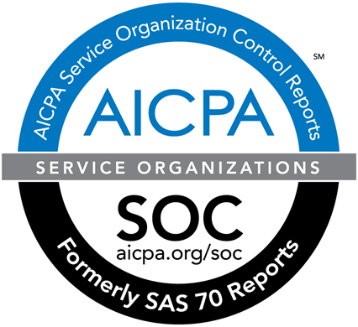
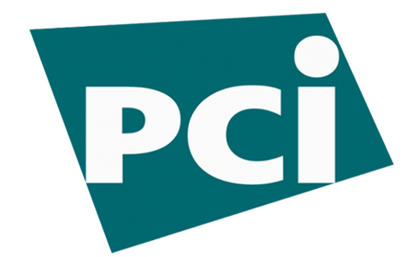
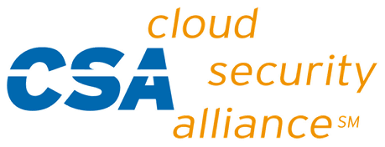

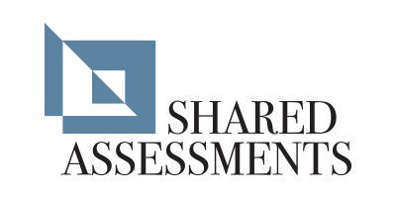
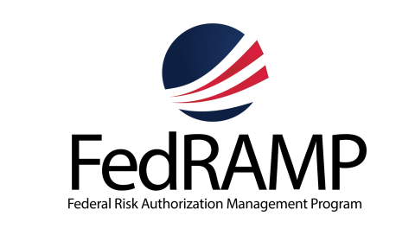



















The trusted cloud
ISO 27018
More certifications than any other cloud provider
Industry leader for customer advocacy and rights protection
More global DC regions than any other provider

Slide 5
Microsoft Secure
Notes:
https://microsoft.sharepoint.com/sites/infopedia/media/details/AEVD-3-124183

Slide 6
Unique point of view: cloud is a model, not just a place
Cloud model is geared for speed
Developers have a critical business role
Services and apps create new complexity
Server is no longer the center point
App is king—app data is business data
Public
Private
Hosted
Notes:
Model Not Location”

Slide 7
Azure Cloud Computing Capabilities
On-Premises
( Private Cloud )
Infrastructure
( as a Service )
Platform
( as a Service )
Software
( as a Service )
You Manage
You Manage
Data & Access
You Provision & Manage
Data & Access
Data & Access
Data & Access
You Provision & Manage
Applications
Applications
Applications
Applications
Provisioned & Managed by Vendor
Runtime
Runtime
Runtime
Provisioned & Managed by Vendor
Runtime
Operating System
Operating System
Operating System
Operating System
Virtual Machine
Virtual Machine
Virtual Machine
Virtual Machine
Physical Fabric Managed by Vendor
Compute
You Provision Cloud Services
Compute
Compute
Compute
Networking
Networking
Networking
Networking
Storage
Storage
Storage
Storage
Host
Develop
Consume

Slide 8
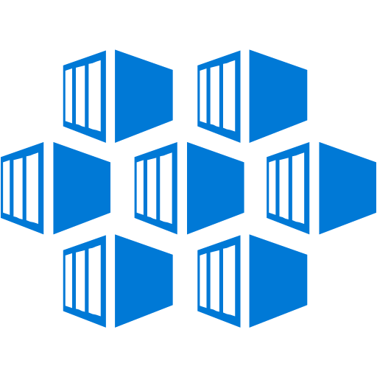

Azure IaaS – beyond traditional virtualization
Virtual
machines (VM),
VM scale sets
Containers
with Docker
Networking
Storage
Key Vault
Rapid deployment with automated scaling
Linux and Windows Server containers
Virtual network, load balancer, VPN gateway
Blobs, tables, queues
Securely protect application keys and secrets

Slide 9

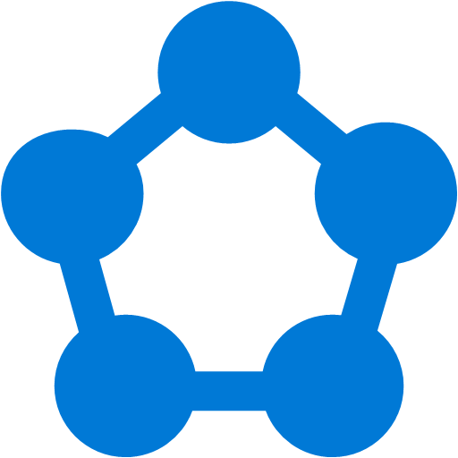
Azure PaaS – high productivity development
Azure App Service
Azure Functions
Azure Service Fabric
Azure Container Service (ACS)
Cloud Foundry
Web, Mobile, and API apps
Serverless Computing
Scalable distributed applications, deploy standalone Service Fabric clusters initially
Container management, with ACS engine support for Docker Swarm, Kubernetes, and Mesosphere DC/OS
Open source platform

Slide 10

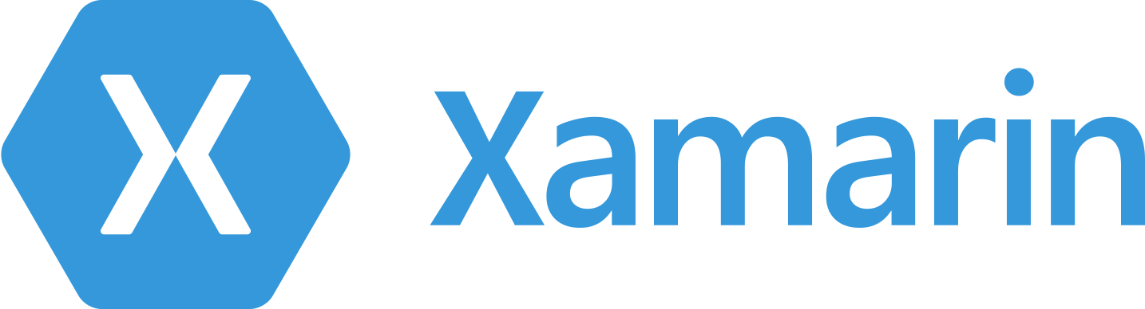
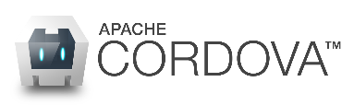
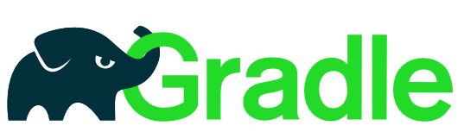

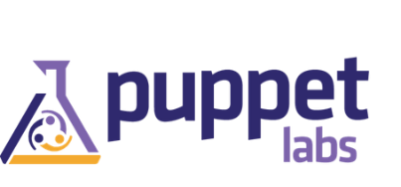

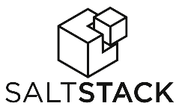




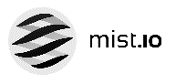


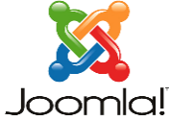

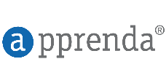
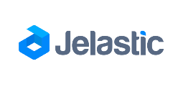
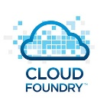
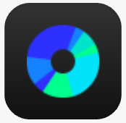



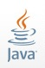






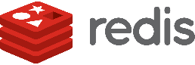

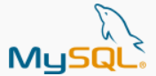

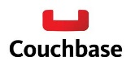






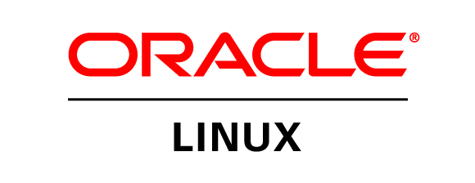
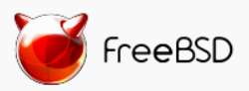

Azure is an open cloud
DevOps
Clients
Management
Applications
PaaS &
DevOps
App Frameworks
& Tools
Databases &
Middleware
Infrastructure
Notes:
P2

Slide 11
Azure: Productive
a
b
c
Integrated tooling for developers
100+ cloud services
Unified management for IT admins

Slide 12
The case for hybrid cloud platform
Business and technical considerations
Application flexibility
Inadequate alternatives
Notes:
Slide 17: The case for hybrid platform
So why even build this hybrid platform? In one word – customer-centricity. Customers told us loud and clear – “We want Azure in our datacenters”.
We heard the following drivers/motivations :
Business requirements
Summarize key requirements: latency, customization, sovereignty,
Make cloud-first innovation possible everywhere
So you can make app deployment decisions based on business need (vs. technology constraints). We will talk a little more about the innovation possibilities that this opens up in another slide.
Finally, customers are finding that the alternatives they have don’t meet their needs (de-positioning competition)
POSITIONING STATEMENT (all-up) For organizations that are looking for speed and innovation of cloud computing in their datacenter, Microsoft Azure Stack offers the only hybrid cloud platform that is truly consistent with a leading public cloud. Only Microsoft can bring proven innovation – including higher level PaaS services – from hyper-scale datacenters to on-premises environments to flexibly meet customers’ business requirements.
Based on the above, we have internalized that “cloud-first” needs to be fully enabled across on-premises and public environments. Ultimately, we want you to be to embrace cloud-first on your terms – every transformation journey is different and we want to be respectful of that. We want you (and your business) to focus your energies and resources on the things that really matter – i.e. the things that differentiate your product or service in the market. That’s really why we’re doing this work on enabling platform consistency so you don’t need to spend cycles attempting to do that on your own.

Slide 13
Your World …
Cloud
On-Premises

Slide 14
Consistent hybrid environment
Azure Active Directory
Azure Data Services
Azure Services
Azure Security & Management
Common identity
Data platform
Unified development
Security & management
Active Directory
SQL Server
Azure Stack
On-premises Infrastructure

Slide 15
Hybrid use cases: Azure and Azure Stack
Edge and disconnected solutions
Cloud applications to meet varied regulations
Cloud application
model on-premises

Slide 16



Azure Stack is an extension of Azure Consistent hybrid environment
Consistency
Azure
Azure Stack

Slide 17


Azure Stack
Consistent
application development
Azure services
available on-premises
Integrated
delivery experience

Slide 18
Customer cloud journey
On-premises
b
Applications
Migration & modernization
Cloud-native
SaaS
Data + intelligence
Data reality
Rehost
Refactor
Rearchitect
Rebuild/New
Replace
Infrastructure
DevOps
Virtual Machines
Containers
App, Data, & AI Services
Notes:
Talking points:
I shared earlier in this session how we are uniquely positioned to provide an end-to-end customer cloud journey.
In the context of application development, we provide different approaches to modernize your apps.
Application modernization is a journey to digitally transform your business applications to make them future-ready.
We meet your customers where they are: Some applications are ready to modernize; some may require minor changes in code; and still others may need a complete redesign to make them cloud-ready. Choosing the right migration approach for different applications in your portfolio can help you extract maximum value from cloud-enabled and innovative technologies.
On this section our focus is the impact, importance, and the business opportunity that application modernization provides to our partner ecosystem.

Slide 19





Cloud on your Terms
Evolution toward highly virtual, and beyond to cloud
Public
Private
Virtual
Physical

Slide 20

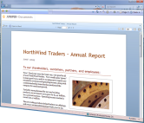
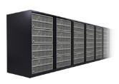
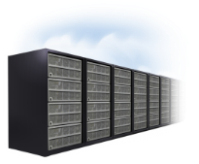

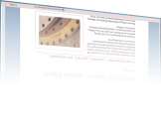



Cloud on your Terms
Choose Your Device (BYOD)
The cloud on your terms
`
Online
On-premises
Unified Communications
Business Intelligence
Content Management
Collaboration
Search

Slide 21
Eight Questions You Should Ask
Who has access to my data?
Are they certified to operate in a compliant environment?
Where is my data stored?
How is my data isolated?
What happens if there is a problem?
What is the response to a legal request?
What is the vendor’s history?
What is the product roadmap?
Source: Gartner

Slide 22
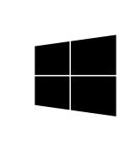


New era of computing
PC Era
Internet Era
Cloud Era
Connecting servers, PCs, and networks
A PC on every desktop
On-demand productivity and hybrid flexibility

Slide 23


Your vision. Your cloud.

